Slide 1
01: Functions & Calculus
Dr. Hamish Carr

Slide 2
Contents
Functions
Manifolds
Differentiation
Integration
Calculus of Multiple Variables
Continuity
Numerical Calculus

Slide 3
Functions
Also known as maps
Define a relationship between two sets
Domain
Range (aka Codomain)
Given a value in the domain
Assign a value in the range

Slide 4
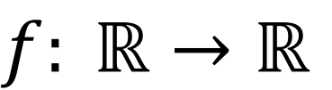
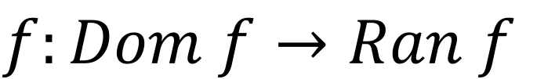
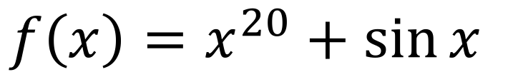
Notation
Most general:
More specific:
Explicit:
$$f:Dom f→Ran f$$
$$f: ℝ→ℝ$$
$$f\left(x\right)=x^{20}+\sin{x}$$

Slide 5
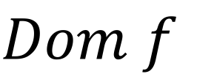
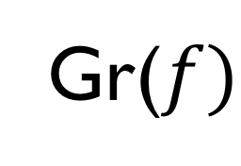

Graph of a Function
Gr($f)$
Ran$f$
$$Dom f$$
$$Gr\left(f\right)=\{\left(x,y\right):x∈Dom f, y=f(x)∈Ran f\}$$
Set of points defined by the function
Notice we are now in 2-D
The embedding space of the graph

Slide 6
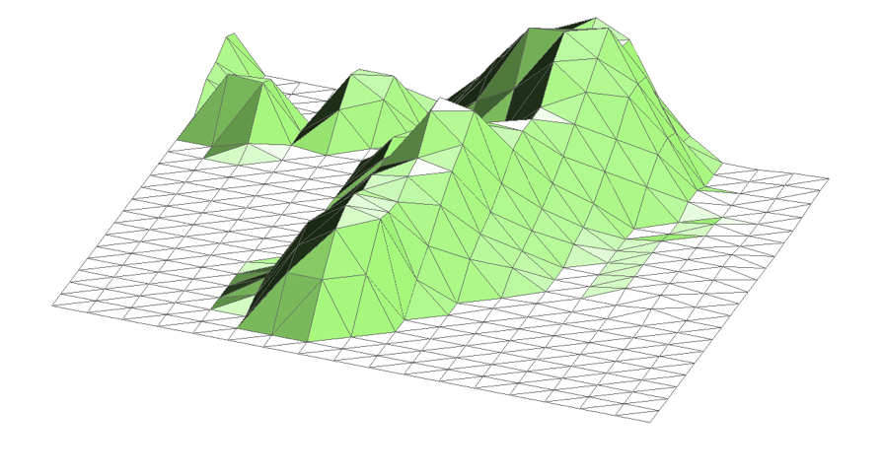
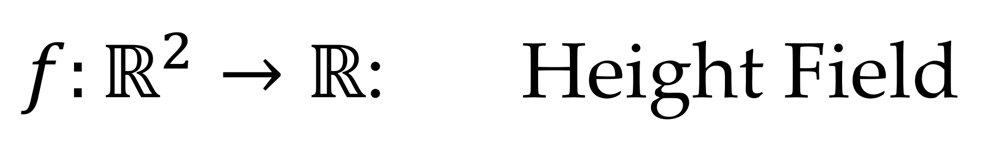
$f:ℝ^{2}→ℝ$: Height Field
For every point in the plane, define a height
The graph is then a terrain
i.e. a surface in a 3D embedding space

Slide 7
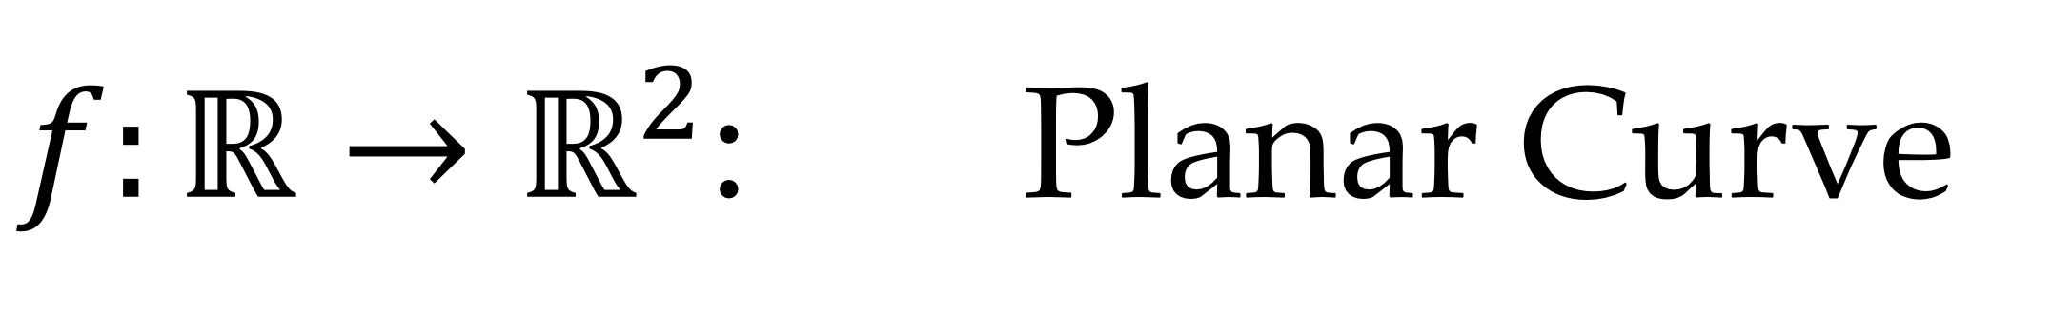
$f:ℝ→ℝ^{2}$: Planar Curve
Also known as a parametric curve
Assigns (x,y) coordinates to each t value
Can self-intersect, &c.

Slide 8
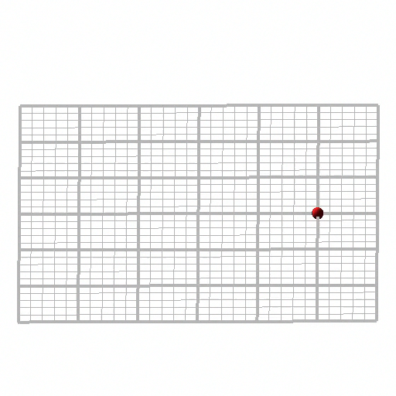
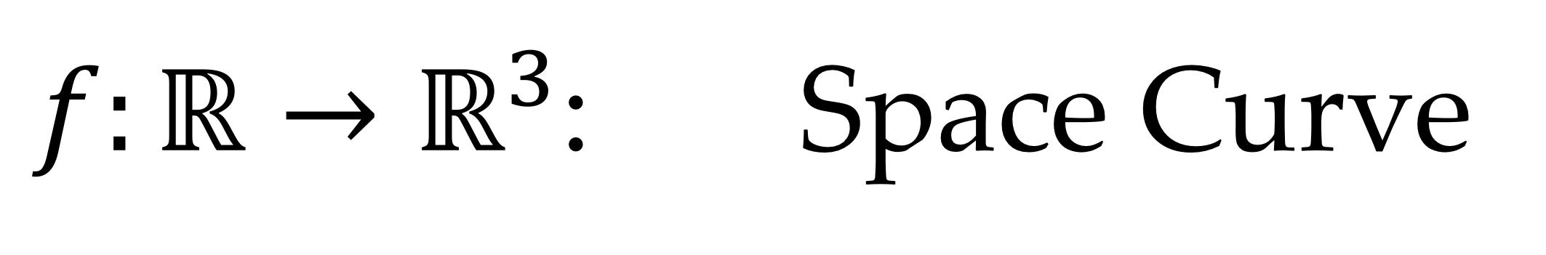
$f:ℝ→ℝ^{3}$: Space Curve

Slide 9
Vector Fields
Fields whose output is a vector
Range has same dimension as domain
And there is added semantic meaning
Frequently represents flow

Slide 10
Manifolds
Generalisation of the idea of surfaces
Sets that are locally equivalent to surfaces
Defined for any dimension
1-manifold – a curve
2-manifold – a surface
3-manifold – a volume
Always exist in an embedding space

Slide 11
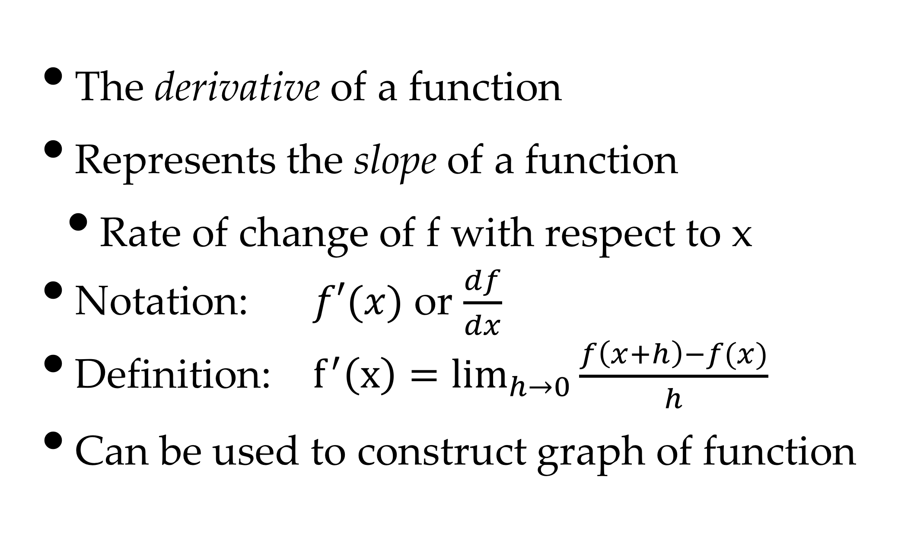
Differential Calculus
The derivative of a function
Represents the slope of a function
Rate of change of f with respect to x
Notation: $f′(x)$ or $\frac{df}{dx}$
Definition: $f^{′}\left(x\right)=\lim_{h→0}{\frac{f\left(x+h\right)−f(x)}{h}}$
Can be used to construct graph of function

Slide 12
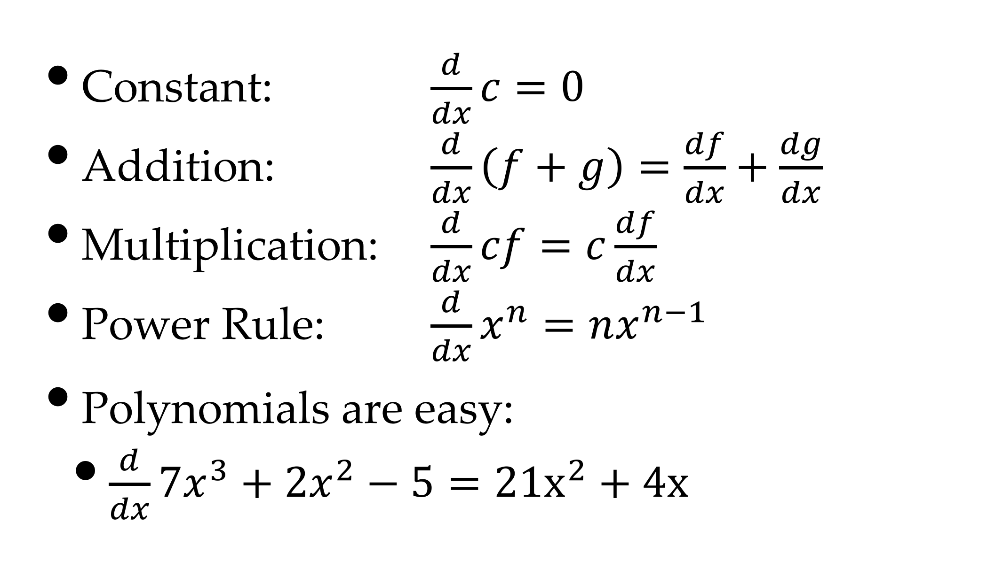
Rules of Differentiation
Constant: $\frac{d}{dx}c=0$
Addition: $\frac{d}{dx}\left(f+g\right)=\frac{df}{dx}+\frac{dg}{dx}$
Multiplication: $\frac{d}{dx}cf=c\frac{df}{dx}$
Power Rule: $\frac{d}{dx}x^{n}=nx^{n−1}$
Polynomials are easy:
$\frac{d}{dx}7x^{3}+2x^{2}−5=21x^{2}+4x$

Slide 13
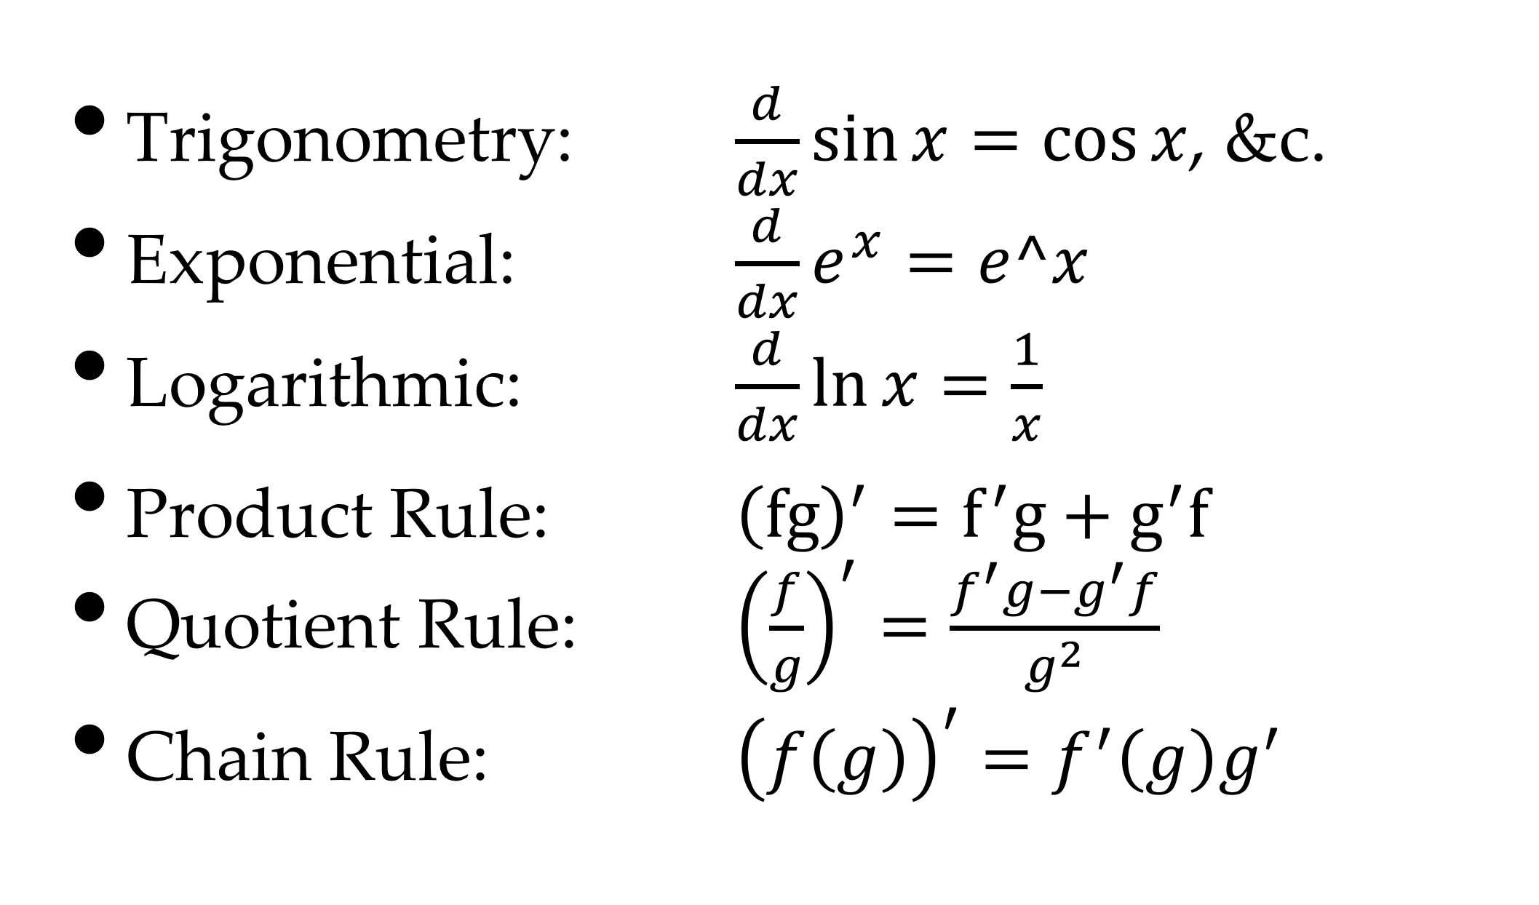
More Rules
Trigonometry: $\frac{d}{dx}\sin{x}=cos⁡x$, &c.
Exponential: $\frac{d}{dx}e^{x}=e^x$
Logarithmic: $\frac{d}{dx}\ln{x}=\frac{1}{x}$
Product Rule: ${\left(fg\right)}^{′}=f^{′}g+g^{′}f$
Quotient Rule: ${\left(\frac{f}{g}\right)}^{′}=\frac{f^{′}g−g^{′}f}{g^{2}}$
Chain Rule: ${\left(f\left(g\right)\right)}^{′}=f^{′}\left(g\right)g^{′}$

Slide 14
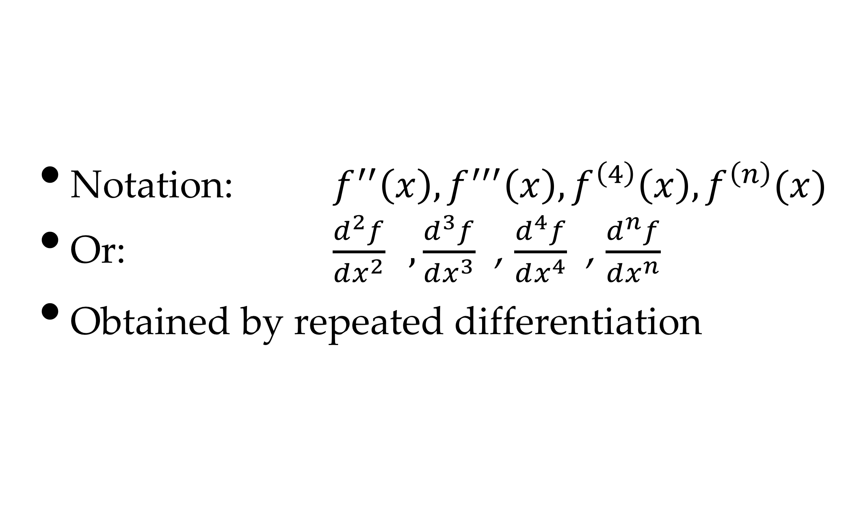
Higher Derivatives
Notation: $f^{′′}\left(x\right), f^{′′′}\left(x\right), f^{\left(4\right)}\left(x\right),f^{\left(n\right)}(x)$
Or: $\frac{d^{2}f}{dx^{2}} ,\frac{d^{3}f}{dx^{3}}$ , $\frac{d^{4}f}{dx^{4}}$ , $\frac{d^{n}f}{dx^{n}}$
Obtained by repeated differentiation

Slide 15
Sketching A Function
<
>
Partition graph into segments
Defined by roots of derivatives

Slide 16
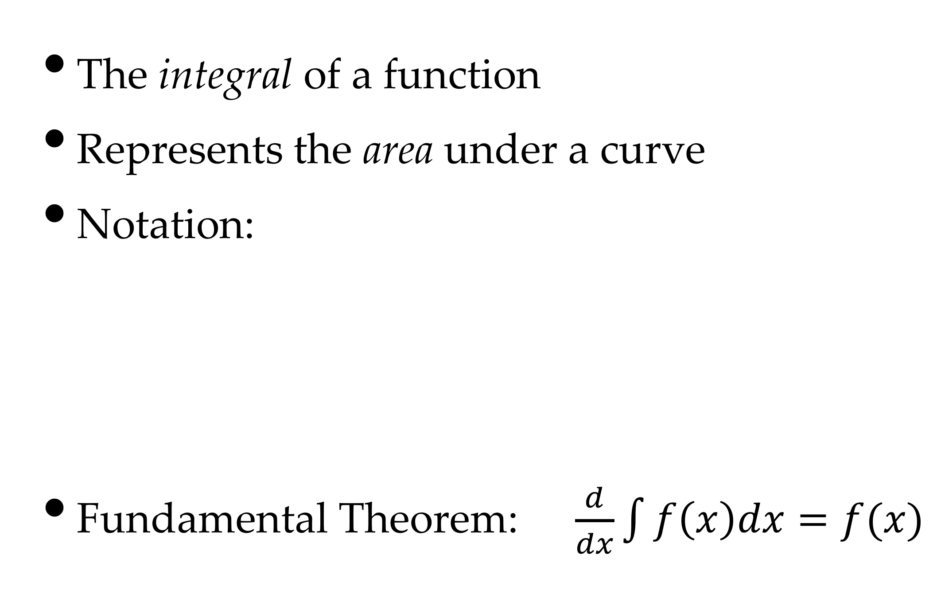
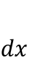
Integral Calculus
The integral of a function
Represents the area under a curve
Notation:
Fundamental Theorem: $\frac{d}{dx}\int{f\left(x\right)dx=f(x)}$
$$dx$$

Slide 17
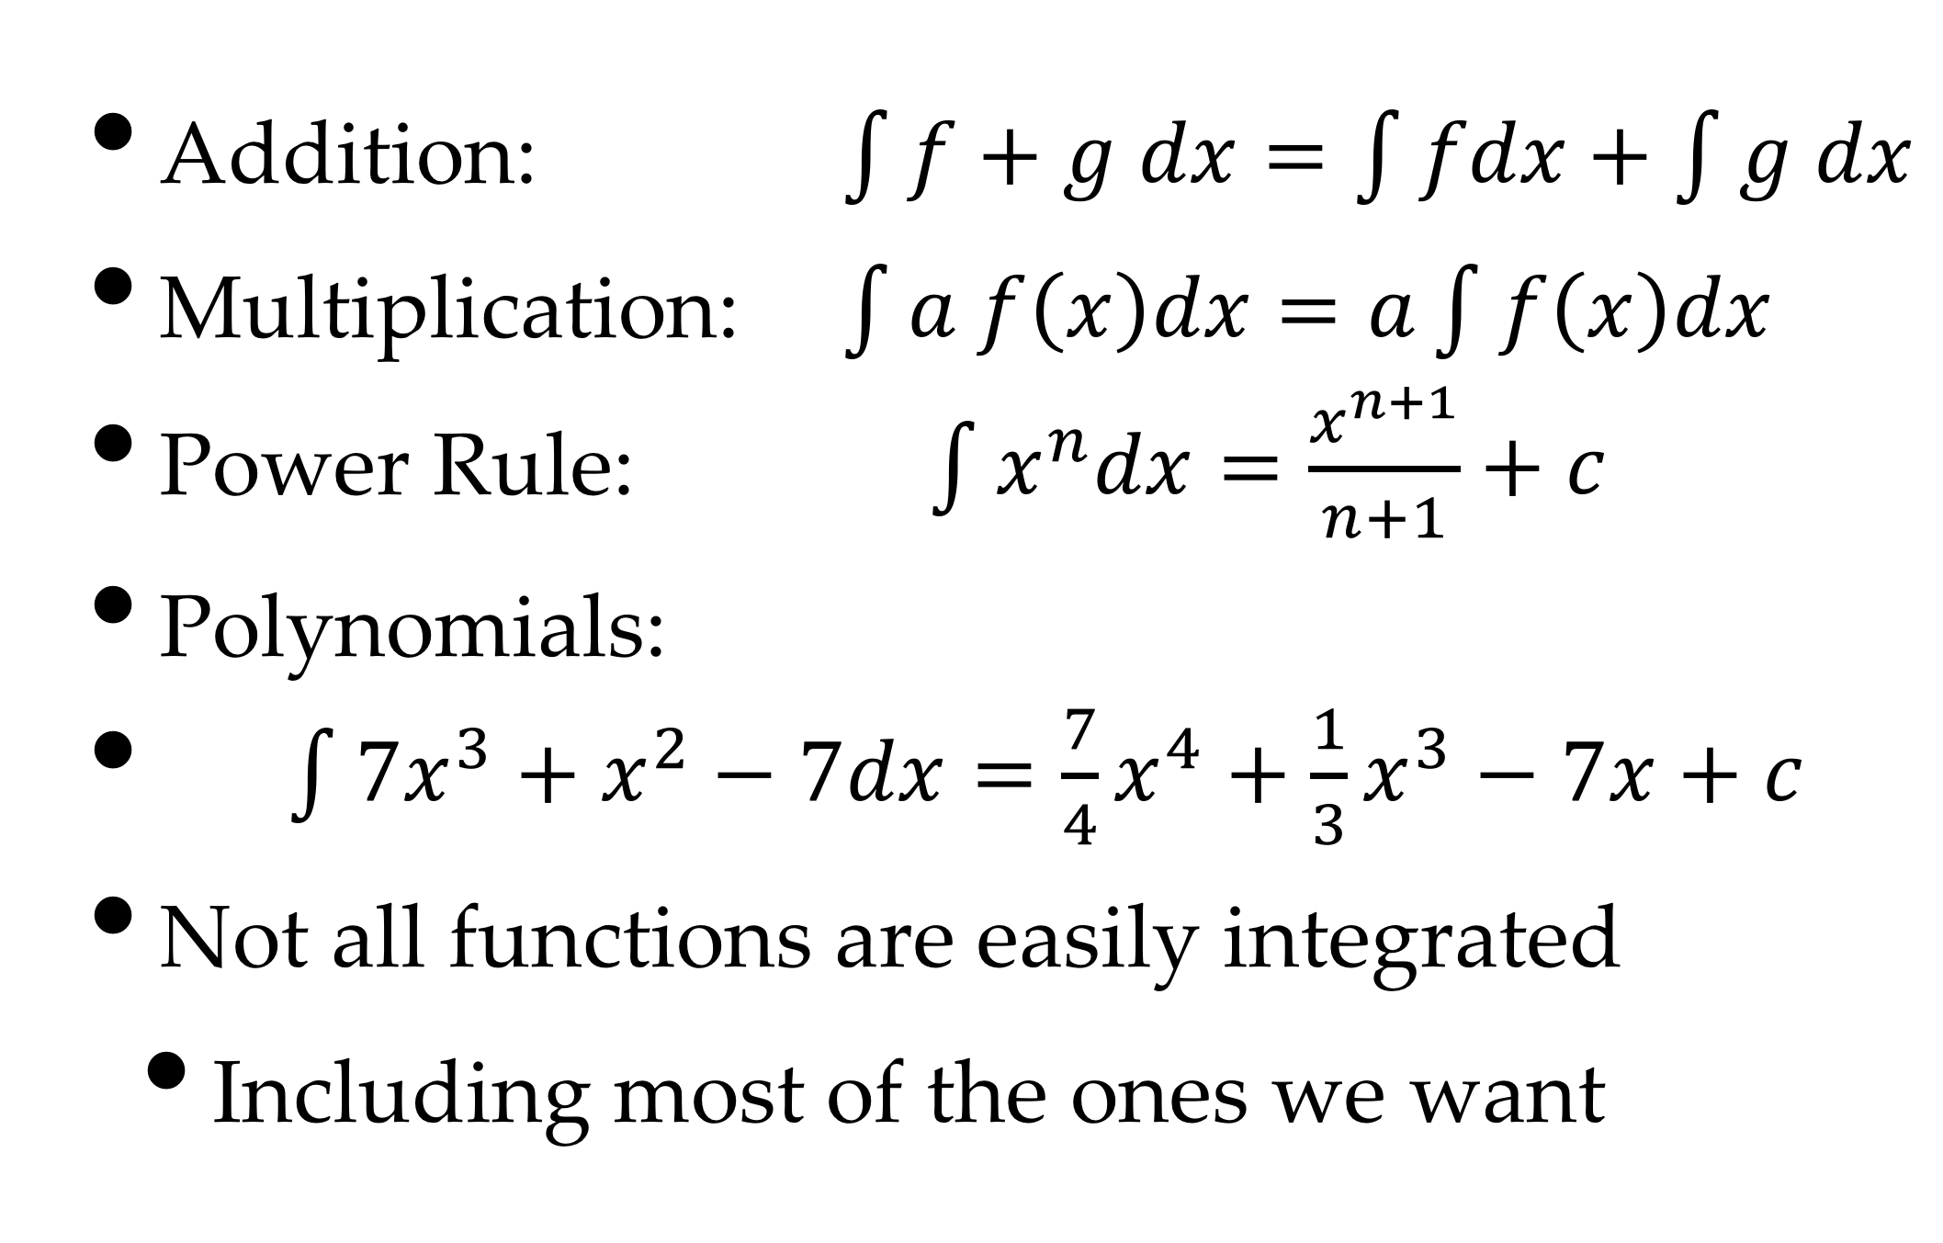
Rules of Integration
Addition: $\int{f+g dx=\int{fdx+\int{g dx}}}$
Multiplication: $\int{a f\left(x\right)dx=a\int{f\left(x\right)dx}}$
Power Rule: $\int{x^{n}dx=\frac{x^{n+1}}{n+1}+c}$
Polynomials:
$\int{7x^{3}+x^{2}−7dx=\frac{7}{4}x^{4}+\frac{1}{3}x^{3}−7x+c}$
Not all functions are easily integrated
Including most of the ones we want

Slide 18
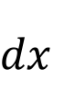
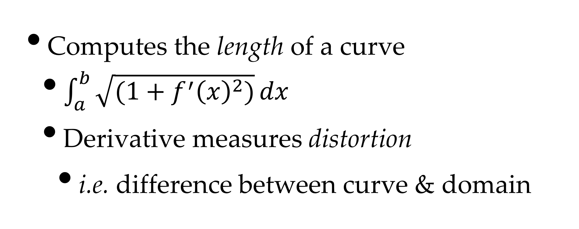
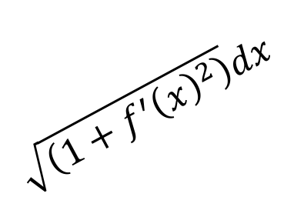
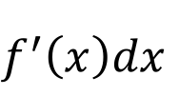
Arc-length Integral
$$\sqrt{\left(1+f^{′}{\left(x\right)}^{2}\right)}dx$$
$$f^{′}\left(x\right)dx$$
$$dx$$
Computes the length of a curve
$\int_{a}^{b}{\sqrt{(1+f^{′}{\left(x\right)}^{2})}}dx$
Derivative measures distortion
i.e. difference between curve & domain

Slide 19
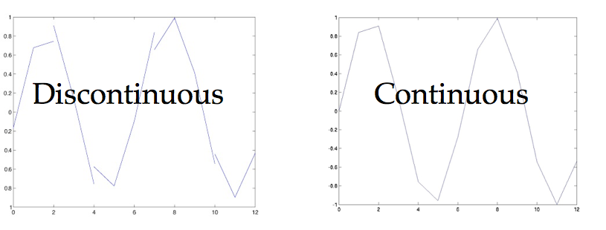
Continuity
A function f(x) is continuous at a if:
Also known as C⁰ continuous

Slide 20
Higher-D Continuity
We extend the idea of the limit
The function is the same from any direction
This leads to epsilon-delta proofs
For our purposes, it generalises

Slide 21
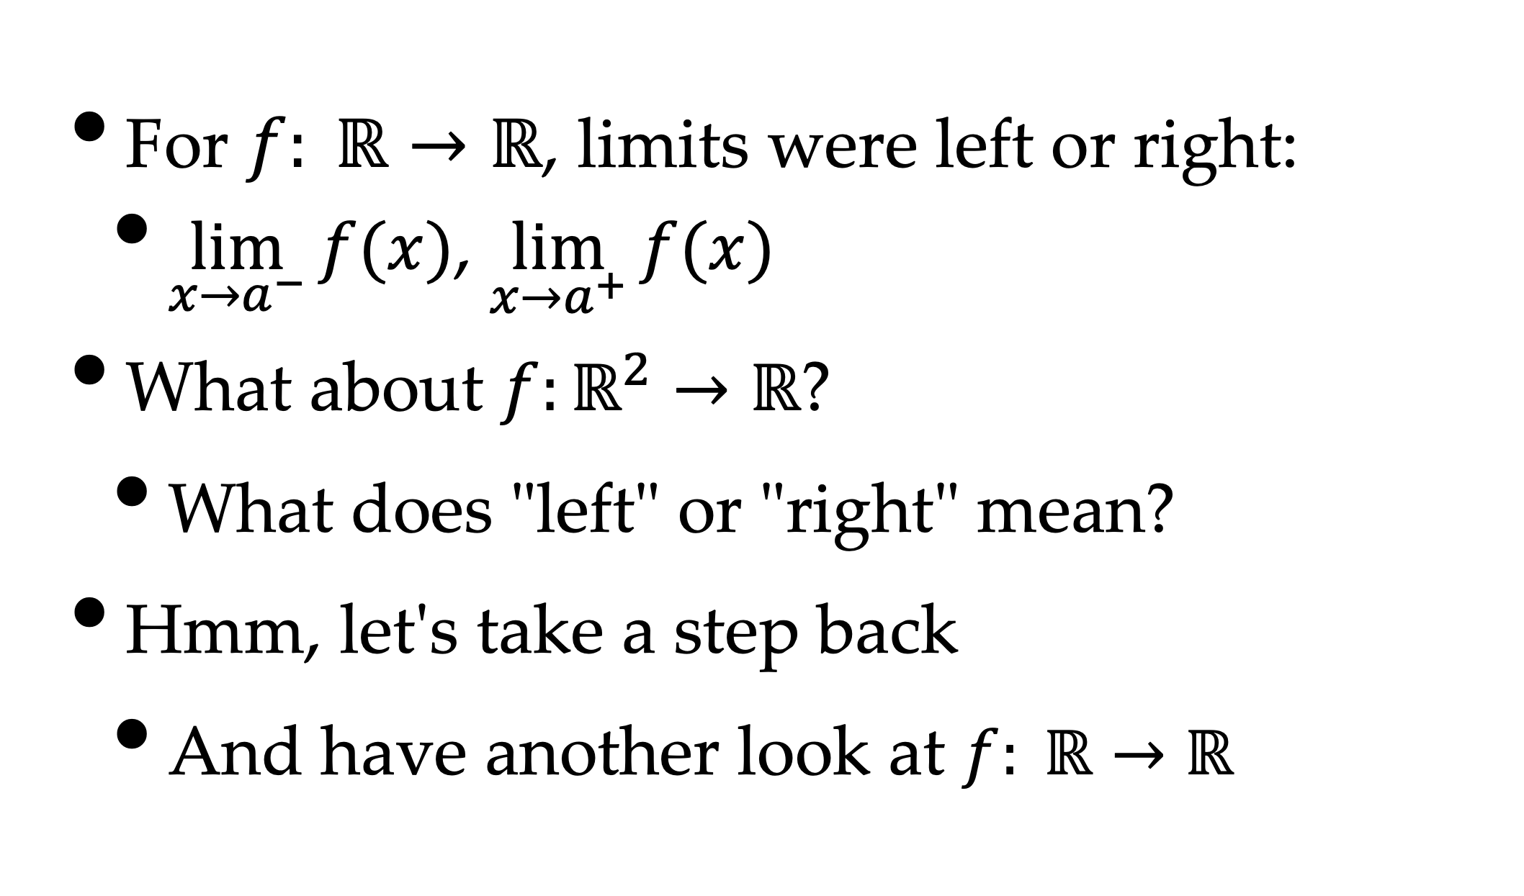
Generalising Limits
For $f: ℝ→ℝ$, limits were left or right:
$\lim_{x→a^{−}}{f(x)}$, $\lim_{x→a^{+}}{f(x)}$
What about $f:ℝ^{2}→ℝ$?
What does "left" or "right" mean?
Hmm, let's take a step back
And have another look at $f: ℝ→ℝ$
a

Slide 22
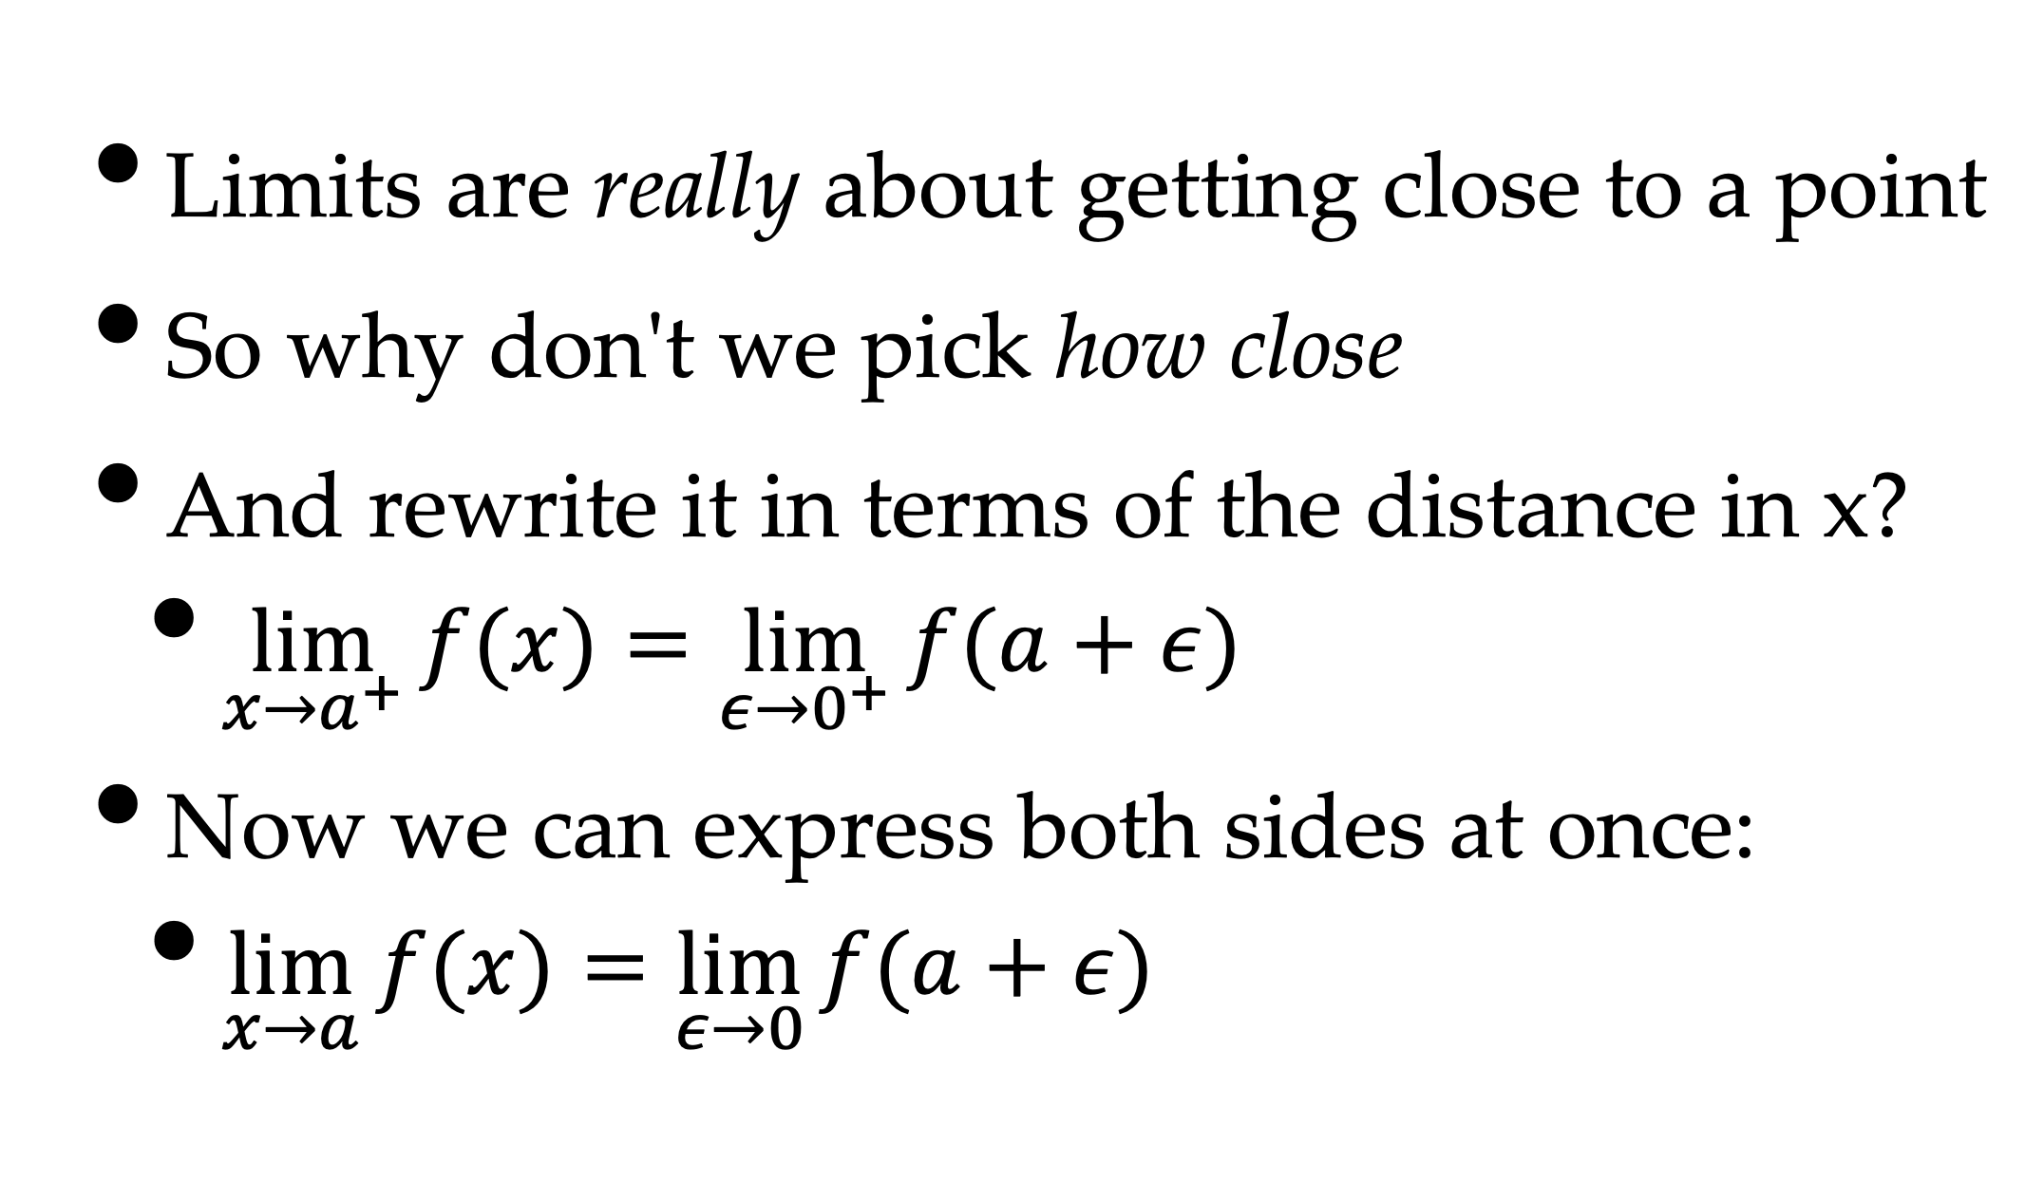
Epsilon Notation
Limits are really about getting close to a point
So why don't we pick how close
And rewrite it in terms of the distance in x?
$\lim_{x→a^{+}}{f(x)}=\lim_{ε→0^{+}}{f(a+ε)}$
Now we can express both sides at once:
$\lim_{x→a}{f(x)}=\lim_{ε→0}{f(a+ε)}$

Slide 23
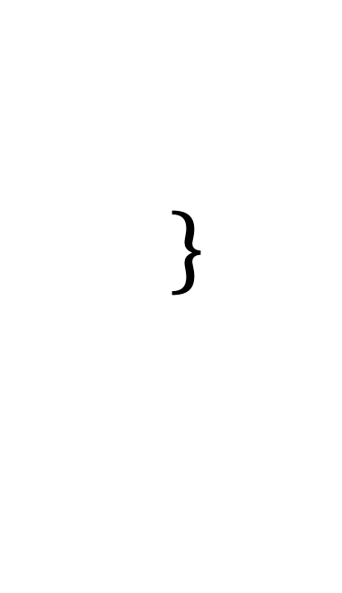
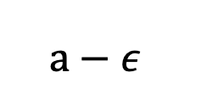
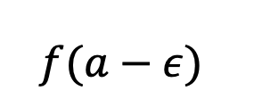
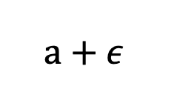
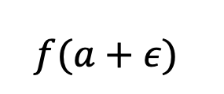
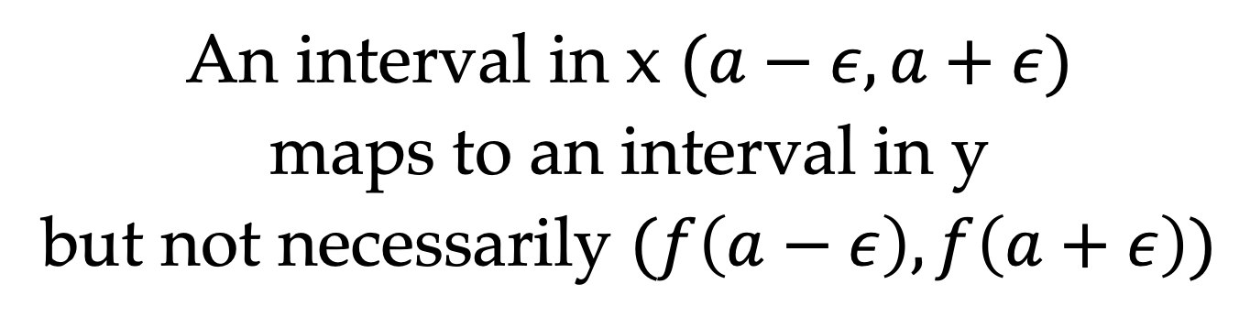
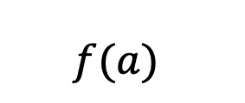
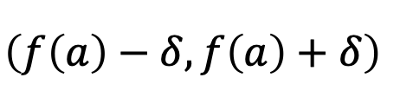
An Example
$$f(a−ε)$$
$$f(a)$$
$$\left(f\left(a\right)−δ,f\left(a\right)+δ\right)$$
$$f(a+ε)$$
$$a−ε$$
a
$$a+ε$$
An interval in x $(a−ε, a+ε)$
maps to an interval in y
but not necessarily $(f\left(a−ε\right), f\left(a+ε\right))$

Slide 24
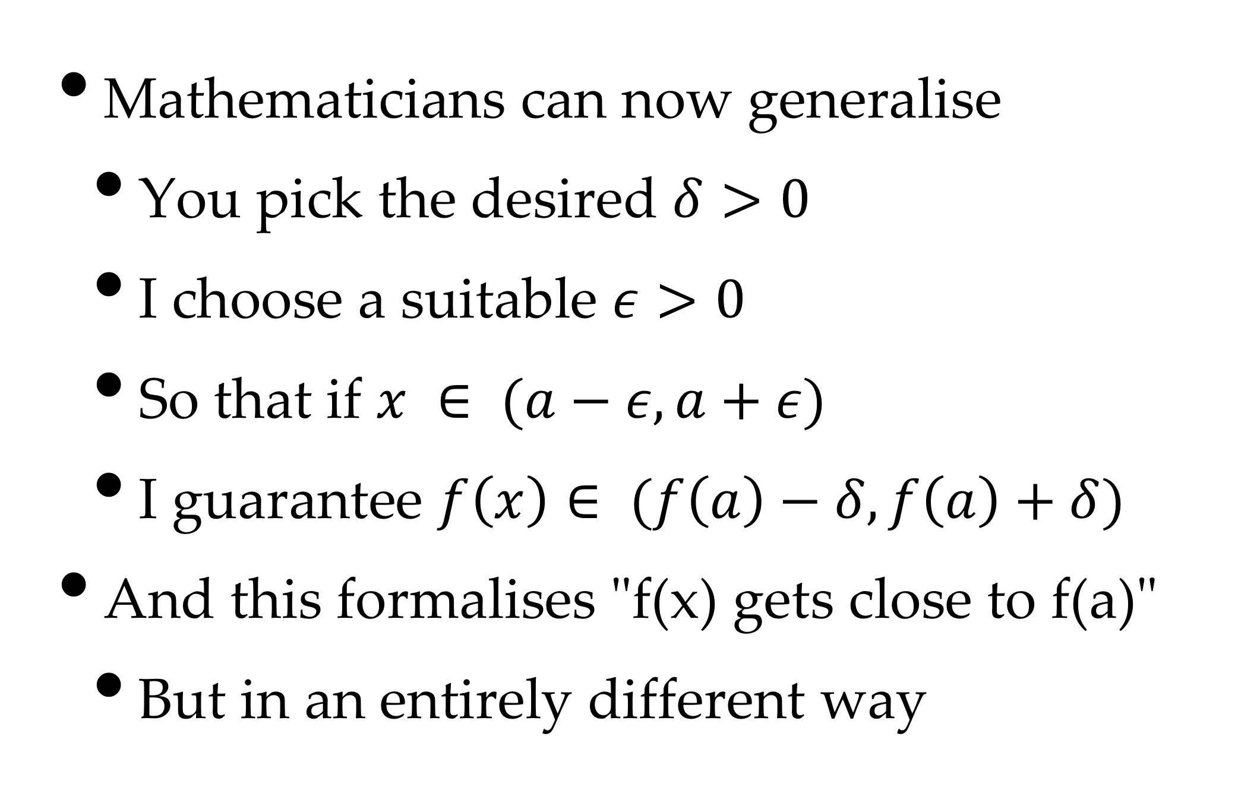
Epsilon-Delta Proofs
Mathematicians can now generalise
You pick the desired $δ>0$
I choose a suitable $ε>0$
So that if $x ∈ (a−ε,a+ε)$
I guarantee $f\left(x\right)∈ (f\left(a\right)−δ,f\left(a\right)+δ)$
And this formalises "f(x) gets close to f(a)"
But in an entirely different way

Slide 25
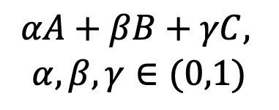
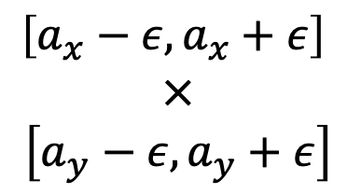
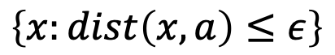
Generalising the Interval
But how do we do this in 2-D?
We generalise the idea of an interval first
But which of the following is best?
Triangle:
Simplest
Polygon
Square:
Product of
Intervals
Circle:
Defined
by Distance
$$αA+βB+γC,$$
$$α,β,γ∈(0,1)$$
$$\left[a_{x}−ε,a_{x}+ε\right]$$
$$×$$
$$\left[a_{y}−ε,a_{y}+ε\right]$$
$$\left\{x:dist\left(x,a\right)≤ε\right\}$$

Slide 26
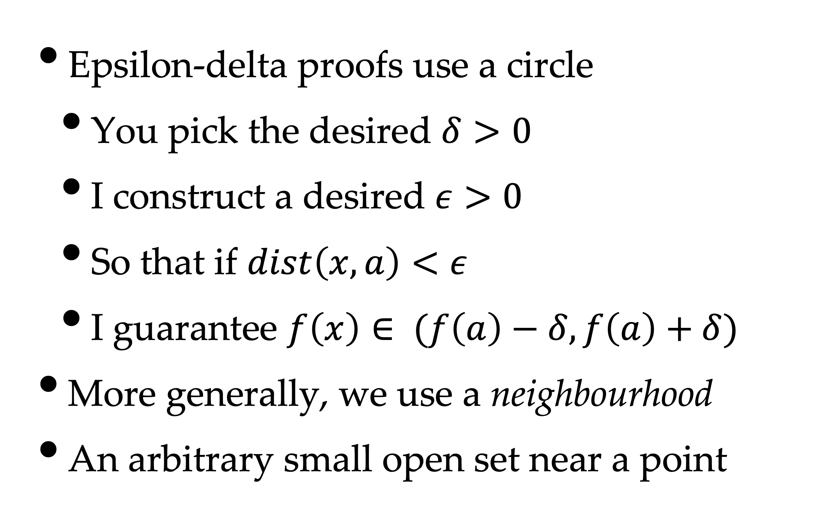
The Neighbourhood
Epsilon-delta proofs use a circle
You pick the desired $δ>0$
I construct a desired $ε>0$
So that if $dist\left(x,a\right)<ε$
I guarantee $f\left(x\right)∈ (f\left(a\right)−δ,f\left(a\right)+δ)$
More generally, we use a neighbourhood
An arbitrary small open set near a point

Slide 27
What does this Mean?
Well, we needed limits to build calculus
Limits express how "close" we are
Which we are always interested in
We can extend calculus to more dimensions
Using epsilon-delta proofs

Slide 28

An Example
f(a)
f(a)
a

Slide 29
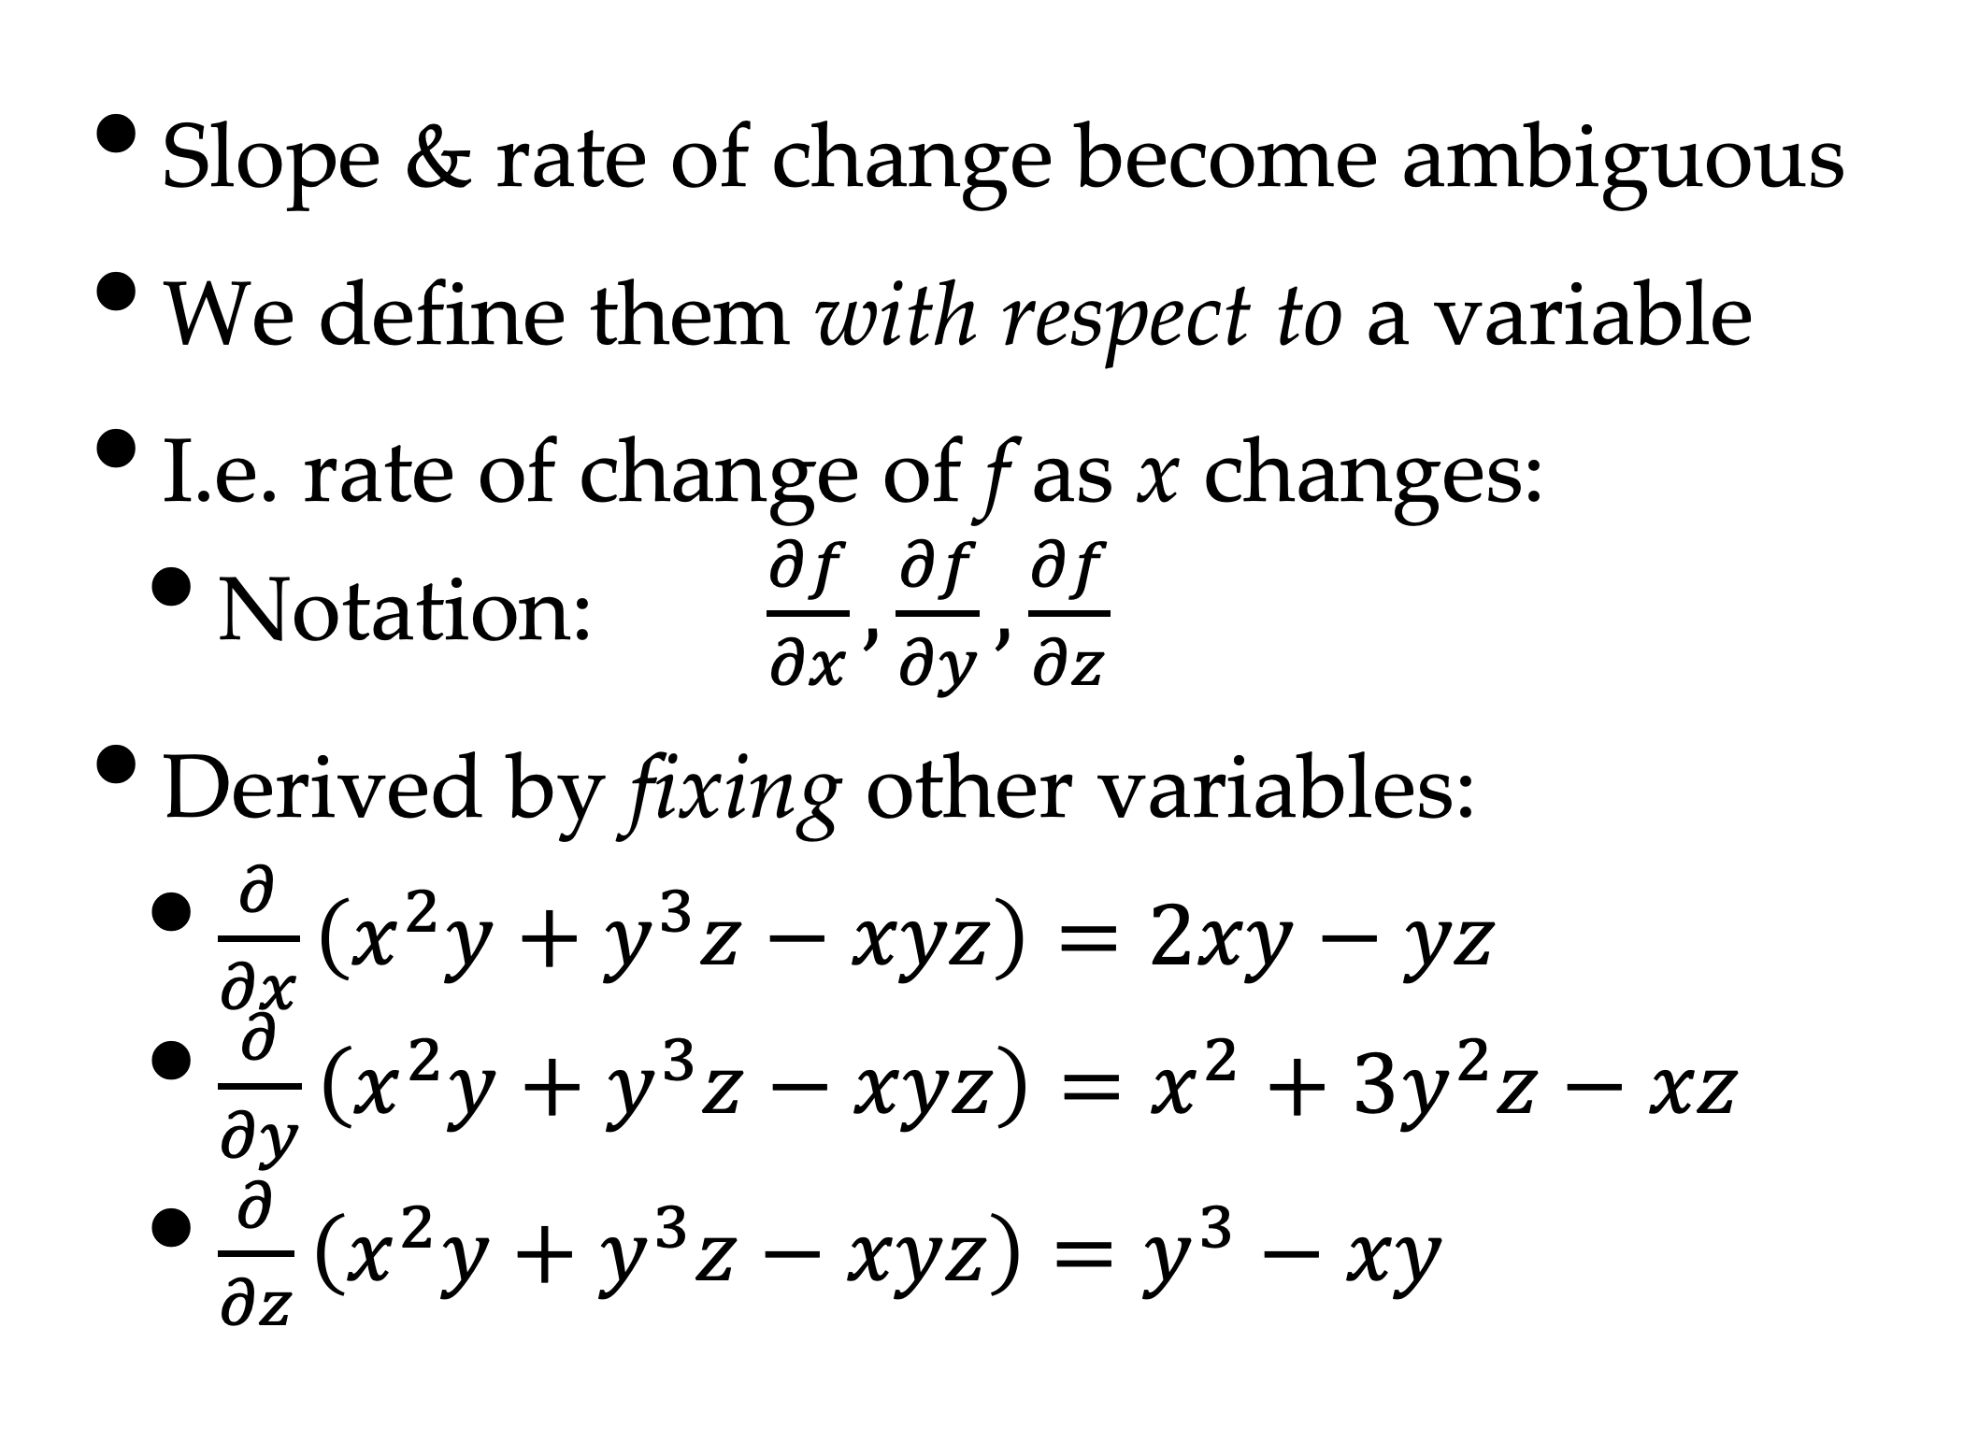
Multi-D Derivatives
Slope & rate of change become ambiguous
We define them with respect to a variable
I.e. rate of change of f as x changes:
Notation: $\frac{∂f}{∂x},\frac{∂f}{∂y},\frac{∂f}{∂z}$
Derived by fixing other variables:
$\frac{∂}{∂x}\left(x^{2}y+y^{3}z−xyz\right)=2xy−yz$
$\frac{∂}{∂y}\left(x^{2}y+y^{3}z−xyz\right)=x^{2}+3y^{2}z−xz$
$\frac{∂}{∂z}\left(x^{2}y+y^{3}z−xyz\right)=y^{3}−xy$

Slide 30
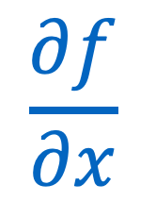
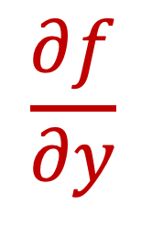
An Example
$$\frac{∂f}{∂y}$$
$$\frac{∂f}{∂x}$$

Slide 31
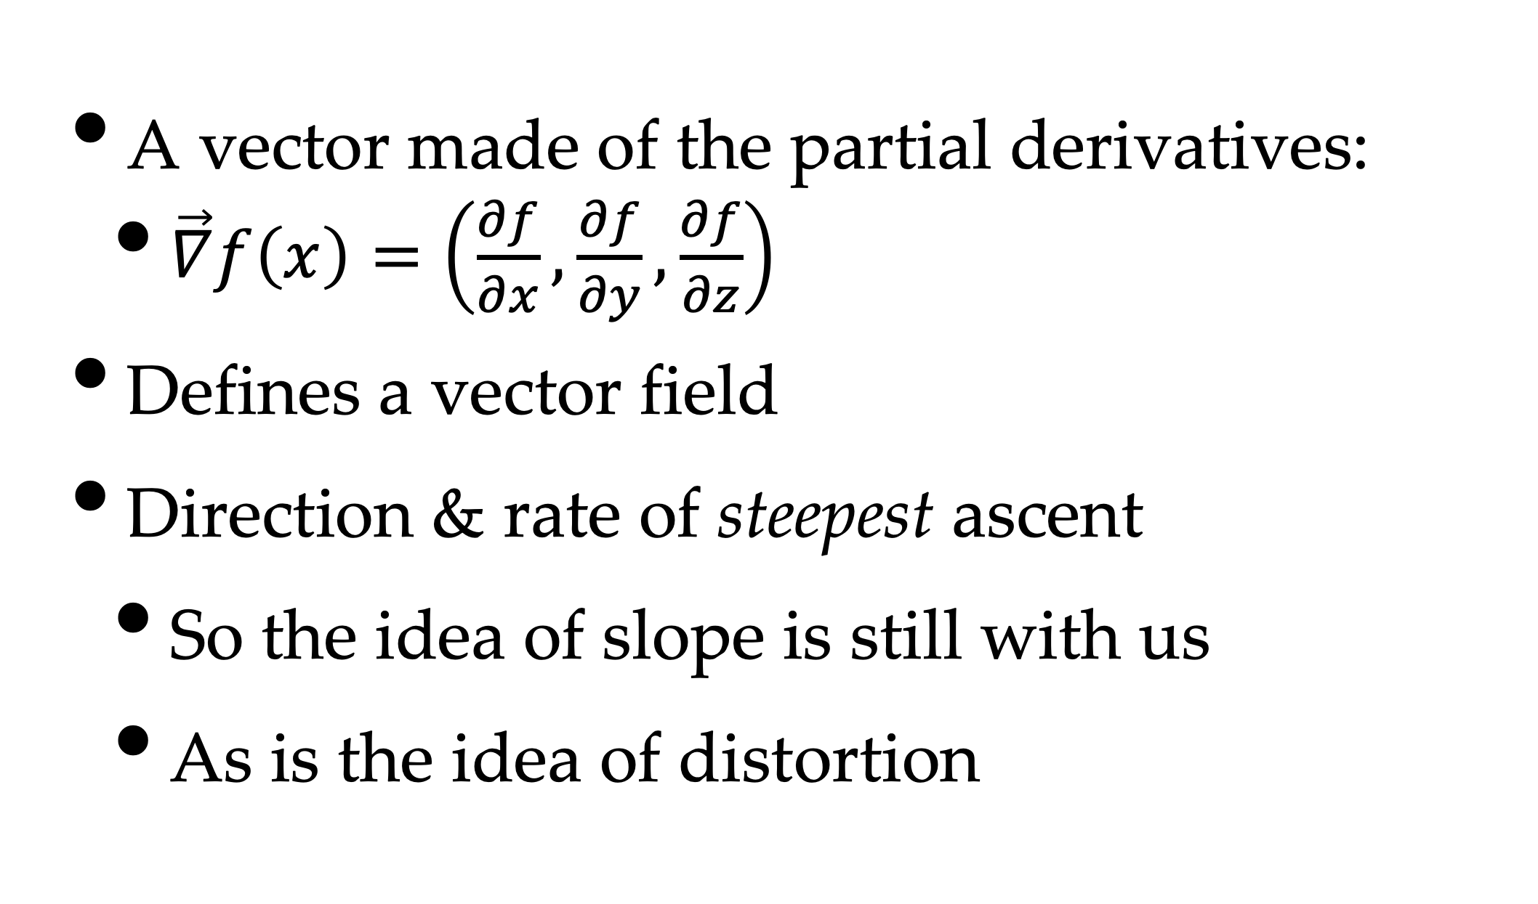
Gradient Vector
A vector made of the partial derivatives:
$\vec{∇}f\left(x\right)=\left(\frac{∂f}{∂x},\frac{∂f}{∂y},\frac{∂f}{∂z}\right)$
Defines a vector field
Direction & rate of steepest ascent
So the idea of slope is still with us
As is the idea of distortion

Slide 32
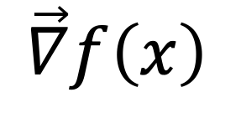
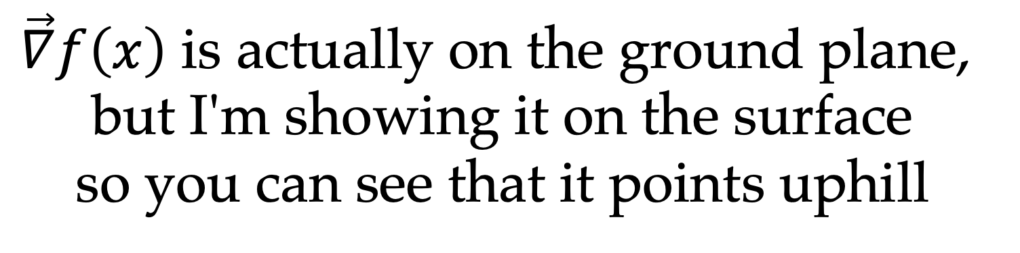
An Example
$$\vec{∇}f\left(x\right)$$
$\vec{∇}f\left(x\right)$ is actually on the ground plane,
but I'm showing it on the surface
so you can see that it points uphill

Slide 33
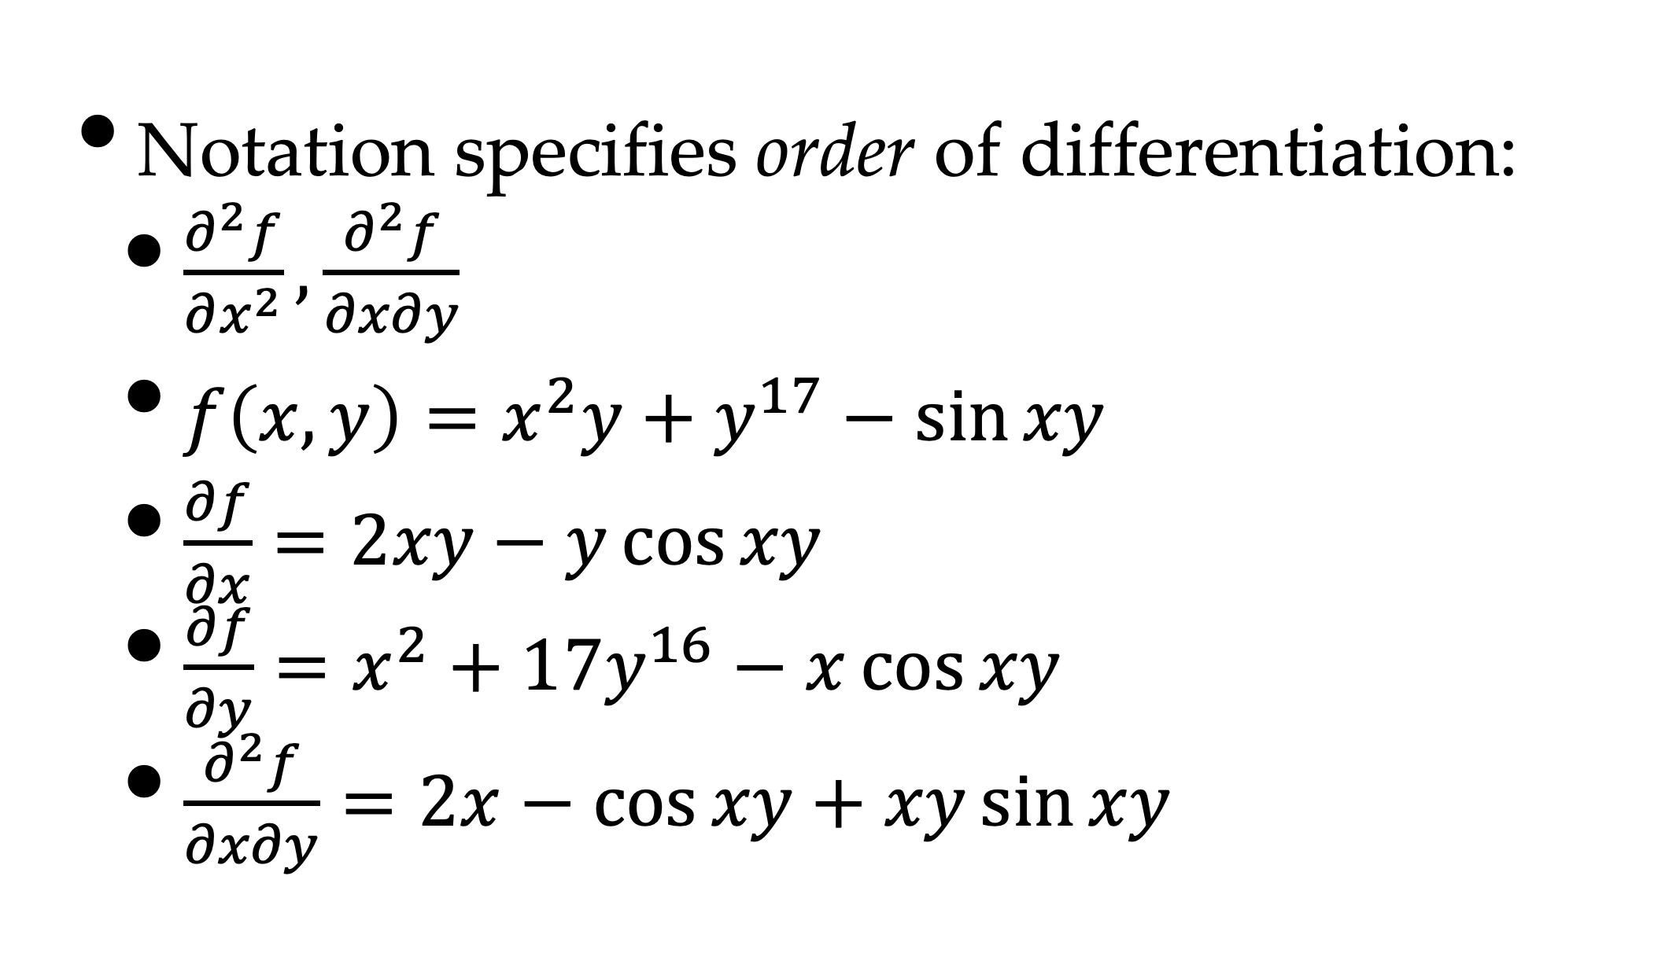
Higher-Order Partials
Notation specifies order of differentiation:
$\frac{∂^{2}f}{∂x^{2}},\frac{∂^{2}f}{∂x∂y}$
$f\left(x,y\right)=x^{2}y+y^{17}−\sin{xy}$
$\frac{∂f}{∂x}=2xy−y\cos{xy}$
$\frac{∂f}{∂y}=x^{2}+17y^{16}−x\cos{xy}$
$\frac{∂^{2}f}{∂x∂y}=2x−\cos{xy}+xy\sin{xy}$

Slide 34
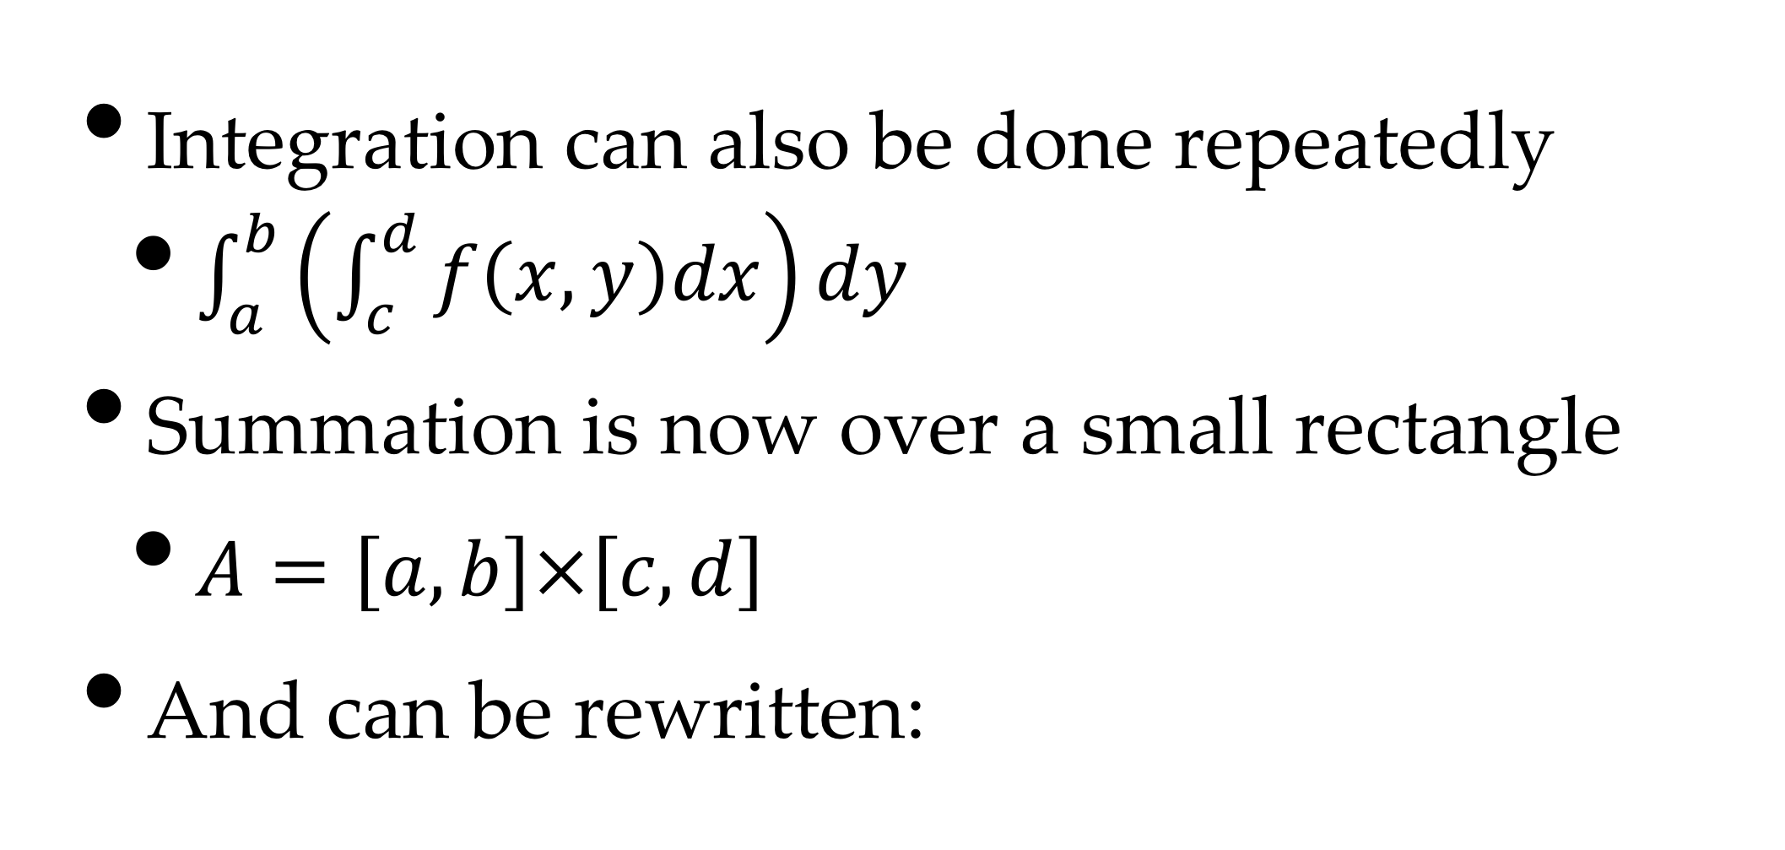
Multiple Integrals
Integration can also be done repeatedly
$\int_{a}^{b}{\left(\int_{c}^{d}{f\left(x,y\right)dx}\right)dy}$
Summation is now over a small rectangle
$A=\left[a,b\right]×\left[c,d\right]$
And can be rewritten:

Slide 35
Numerical Calculus
Most of our functions will not be integrable
We will approximate them numerically
There are a number of methods:
Taylor Series
Numerical Integration
Table Lookup

Slide 36
Taylor Series
For any function f(x)
We choose an easy value for a.
For example, look at cosine, with a=0
Many functions converge slowly

Slide 37
Numerical Integration
We just go back to our summation:
And choose a small
The rest is standard numerical computation

Slide 38
Table Lookup
A lot of computations are reused
e.g., sin, cos, logarithm
And we may not need high accuracy
So store a lookup table
an array with (e.g.) 1024 values
Then just take the closest value
This runs a lot faster

